Slide 1
Impact of Androgen Deprivation : Treatment Challenges in metastatic cancer Prostate
Muhammad Abdus Salam
Professor of Uro Oncology
Chairman Urology and Transplantation
Foundation of Bangladesh
www.utfbbd.Com

Slide 2
Disease States and Natural History
5 - 15 yrs
2 - 5 yrs
40-60%
Localized
Biochemical relapse
Metastatic
Death
Biochemical HRPC
Met HRPC
3.5 yrs
1.5 yrs

Slide 3
The History of Hormonal Therapy for Advanced Prostate Cancer
localized PCa
biochemical relapse
symptomatic bone mets
asymptomatic
bone mets
LHRH analogs
orchiectomy
PSA
1940’s
1980’s
1990’s
2000’s

Slide 4
Case studies 1
67 year old man with mCAP
LHRH Analogue+ Bicalutamide = 6 months
PF 100%
BMI 26
Current Problem
Loss of Libido
Fatigue
Central Obesity

Slide 5
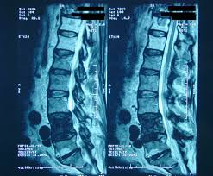
Case study 2
A 79-year-old retired businessman
Postradical prostatectomy 2013 for a Gleason 7, T2B, margin positive, node negative prostate cancer.
He received postoperative radiation therapy
prostate-specific antigen (PSA) level was undetectable on annual visits until last year.
In the past 12 months, PSA has climbed from 1.2 to a present value of 53.4. and he developed paraplegia and retention of Urine
Put on Degarilax and Bicalutamide for CAB
His Neurological function was recovered by three months, PSA came down to .09ng/ml and can pass urine and can walk with a stick
Now his problem is Fatigue, Loss of Libido, Severe ED,

Slide 6
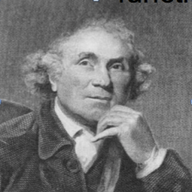
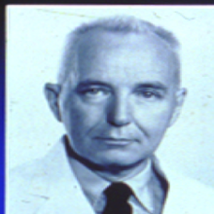
History of Prostate cancer Management
1780 John Hunter, castration
1938 Acid phosphatase
1940 Huggins, Orchiectomy and estrogen (Nobel Prize)
1965 Synthetic estrogens
1977 First generation non-steroidal anti-androgens
1989 2nd generation non-steroidal AA (bicalutamide)
1985 Schally, LHRH agonists (Nobel Prize)
2003 LHRH antagonist (abarelix)
2008 Degarelix
2009 Abiraterone
2010 Sawyer, Enzalutamide

Slide 7
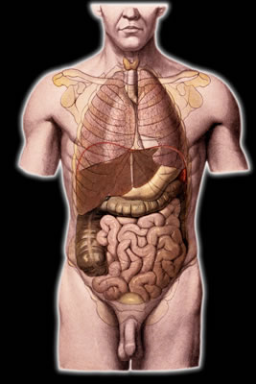
Testosterone is the major “male” hormone
Skin
Hair growth, balding, sebum production
Brain Libido, mood
Liver
Synthesis of serum proteins
Muscle
Increase in strength and volume
Kidney
Stimulation of erythropoietin production
Bone
Accelerated linear growth, closure of epiphyses
Male sexual organs
Penile growth, spermatogenesis, prostate growth and function
Bone marrow
Stimulation of stem cells
Notes:
7
Testosterone is the most important circulating hormone in the male. Besides being essential for the development of male characteristics and male sexual organs it also has effects on most of the major organs, such as Brain, Muscle, Kidney, Bone Marrow, Bone, Liver, and Skin. As men age, testosterone levels decrease, and these decreasing levels in testosterone may present the following clinical problems:
Sexual dysfunction
Decreased Muscle Mass
Increased ratio of fat to lean body mass
Decrease in Bone Mineral Density and/or Osteoporosis
Decreased body hair
Decreased hematopoiesis
Poor ability to concentrate

Slide 8
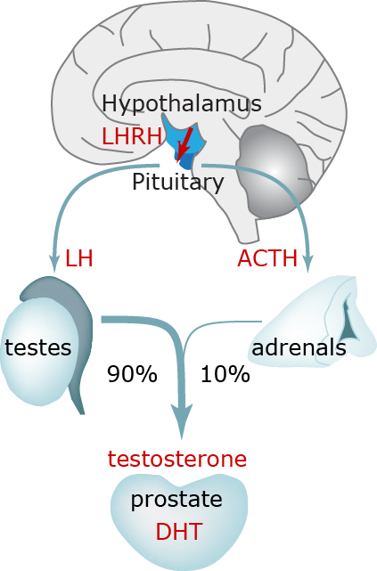
Primary objective of advising ADT
Testosterone is directly responsible for growth of Prostate cancer tissue

Slide 10
Orchiectomy
"Gold standard" of ADT¹
Simple procedure¹
Free of complications¹
Can be done using local anaesthetics¹
Castration level achieved within less than 12h¹
Negative psychological effect of “castration”^{1,2}
Irreversible^{1,3}
Does not allow neoadjuvant, adjuvant or intermittent therapy¹
Advantages
Disadvantages
ADT, androgen deprivation therapy
Heidenreich A, et al. EAU Guidelines 2013. Available at: http://www.uroweb.org/guidelines/online-guidelines/, Choi S & Lee AK. Drug Healthc Patient Saf. 2011;3:107-119., Lepor H & Shore ND. Rev Urol. 2012;14(1-2):1-12.
Notes:
10
As most androgens in males are produced in the testes, bilateral orchiectomy became the ‘gold standard’ of androgen deprivation by which other therapies are assessed.¹ The procedure is simple, generally free of complications and can be performed using local anaesthetic.¹ It is the quickest way of achieving castration level, usually within 12 h. The main drawback of orchiectomy is the negative psychological effect of castration in some men.¹ Further, orchiectomy is irreversible and does not allow neoadjuvant, adjuvant or intermittent therapy and thus medical therapies, which offer reversible testosterone suppression, have now become the mainstay of treatment.¹⁻³
References:
Heidenreich et al. EAU Guidelines 2013. Available at: http://www.uroweb.org/guidelines/online-guidelines/
Lepor H, Shore ND. LHRH Agonists for the Treatment of Prostate Cancer: 2012. Rev Urol. 2012;14(1-2):1-12.
Choi S, Lee AK. Efficacy and safety of gonadotropin-releasing hormone agonists used in the treatment of prostate cancer. Drug Healthc Patient Saf. 2011;3:107-119.

Slide 11
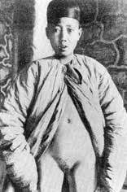
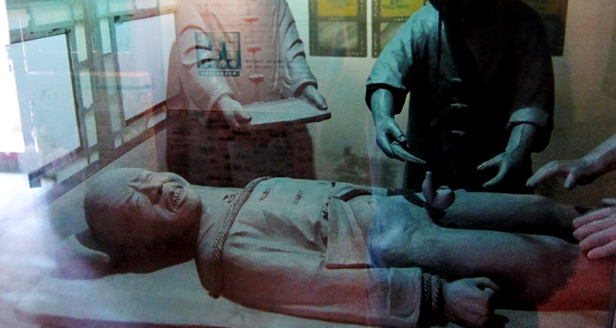
As long ago as the 8th Century B.C., Chinese emperors kept castrated males as palace servants, especially to guard harems.
Mary M. Anderson's Hidden Power: The Palace Eunuchs of Imperial China, Prometheus Press, 1990.
Chinese eunuchs. (Source: Wong KC, Wu L (1932). "History of Chinese Medicine." Tientsin, China: The Tientsin Press Ltd., pp. 109-113.)

Slide 12
Eunocks in the subcontinant

Slide 13
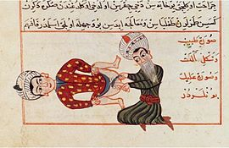
The Eunuchs of Middle east
A medical illustration by Sharaf ad-Din depicting an operation for castration, c. 1466

Slide 14
LHRH Agonist therapy
Effective lowering of testosterone level¹
Patient survival comparable to bilateral orchiectomy^{1,2}
Patients prefer injection over surgical castration³
Generally reversible³
Increased risk of diabetes, heart attack, stroke, and sudden death^{5,6}
Testosterone surge causes a delay in castration^{4,5}
Flare symptoms^{1,5}
Testosterone microsurges^{5,6}
Testosterone breakthroughs⁶
Hormonal adverse events⁷
Testosterone control not comparable with orchiectomy^{8,9}
Advantages
Disadvantages
LHRH, luteinizing hormone-releasing hormone
Heidenreich A, et al. EAU Guidelines 2013. Available at: http://www.uroweb.org/guidelines/online-guidelines/.
Seidenfeld J, et al. Ann Intern Med. 2000;132(7):566-577.
Choi S &Lee AK. Drug Healthc Patient Saf. 2011;3:107-119.
Thompson IM. Rev Urol. 2001;3 Suppl 3:S10-S14.
Van Poppel H, et al. Int J Urol. 2012;19(7):594-601.
Lepor H & Shore ND. Rev Urol. 2012;14(1-2):1-12.
Sharifi N, et al. JAMA. 2005;294(2):238-244.
Morote J, et al. Urol Int. 2006;77(2):135-138.
Tombal B, et al. Eur Urol. 2010;57(5):836-842.
Notes:
14
A meta-analysis showed that LHRH agonists as a class were essentially equivalent to orchiectomy in terms of patient survival.^{1,2} However, LHRH agonists have the advantage of being reversible and patients prefer the less invasive LHRH agonist injections to surgical castration.³
Despite their advantages over surgical castration, LHRH agonist therapy has a variety of drawbacks.
Notably, as LHRH agonists act by over-stimulating the pituitary gland, there is an initial period when there is a large rise in LH secretion, leading to increased testosterone production by the testes.^{4,5} In advanced disease, testosterone surge can cause clinical flare effects which may include increased bone pain, spinal cord compression, obstructive renal failure, acute bladder outlet obstruction, and fatal cardiovascular events.^{1,5} LHRH agonists also exhibit a variety of hormonal adverse effects which may have a significant adverse impact on quality of life.⁶ Also, the speed and degree of testosterone suppression with LHRH agonists is not always comparable to that achieved with orchiectomy, with significant proportions of patients failing to achieve castrate levels of testosterone.⁷
The FDA has recently recommended to include safety warnings on the labels of LHRH agonist regarding an increased risk of diabetes, heart attack, stroke, and sudden death with LHRH agonists.^{5,7}
References:
Heidenreich et al. EAU Guidelines 2013. Available at: http://www.uroweb.org/guidelines/online-guidelines/
Seidenfeld J, Samson DJ, Hasselblad V, et al. Single-therapy androgen suppression in men with advanced prostate cancer: a systematic review and meta-analysis. Ann Intern Med. 2000;132(7):566-577.
Choi S, Lee AK. Efficacy and safety of gonadotropin-releasing hormone agonists used in the treatment of prostate cancer. Drug Healthc Patient Saf. 2011;3:107-119.
Thompson IM. Flare Associated with LHRH-Agonist Therapy. Rev Urol. 2001;3 Suppl 3:S10-S14.
Poppel HV, Klotz L. Gonadotropin-releasing hormone: an update review of the antagonists versus agonists. Int J Urol. 2012;19(7):594-601.
Sharifi N, Gulley JL, Dahut WL. Androgen deprivation therapy for prostate cancer. JAMA. 2005;294(2):238-244.
Lepor H, Shore ND. LHRH Agonists for the Treatment of Prostate Cancer: 2012. Rev Urol. 2012;14(1-2):1-12.
Morote J, Esquena S, Abascal JM, et al. Failure to maintain a suppressed level of serum testosterone during long-acting depot luteinizing hormone-releasing hormone agonist therapy in patients with advanced prostate cancer. Urol Int. 2006;77(2):135-138.
Tombal B, Miller K, Boccon-Gibod L et al. Additional analysis of the secondary endpoint of biochemical recurrence rate in a phase 3 trial (CS21) comparing degarelix 80 mg versus leuprolide in prostate cancer patients segmented by baseline characteristics. Eur Urol. 2010;57(5):836-842.

Slide 15
LHRH Antagonist therapy
Suppresses Production of Testosterone Immediately.
Anti-Androgen therapy is NOT REQUIRED
Faster & Prolonged PSA Suppression
Delays CRPC
Better LUTS relief
No Flare Symptoms
Sustained testosterone control without any Surge & Micro-surge.
Lower risk for patient with diabetes, pre-existing cardiovascular disease.
Injection site reaction
Advantages
Disadvantages
LHRH, luteinizing hormone-releasing hormone
klotz L et al ; BJUI 2008 : 102, 1531-1538;
Rossario D et al; World J Urol. 2016: 1601-1609;
Crawford DE et al; J Urol. 2011; 186 , 889-897
Tombal B. et al. EUR Urol 2010; 57: 836-42;
Notes:
15

Slide 16
LHRH Antagonist therapy
Suppresses Production of Testosterone Immediately.
Anti-Androgen therapy is NOT REQUIRED
Faster & Prolonged PSA Suppression
Delays CRPC
Better LUTS relief
No Flare Symptoms
Sustained testosterone control without any Surge & Micro-surge.
Lower risk for patient with diabetes, pre-existing cardiovascular disease.
Injection site reaction
Advantages
Disadvantages
LHRH, luteinizing hormone-releasing hormone
klotz L et al ; BJUI 2008 : 102, 1531-1538;
Rossario D et al; World J Urol. 2016: 1601-1609;
Crawford DE et al; J Urol. 2011; 186 , 889-897
Tombal B. et al. EUR Urol 2010; 57: 836-42;
Notes:
16

Slide 17
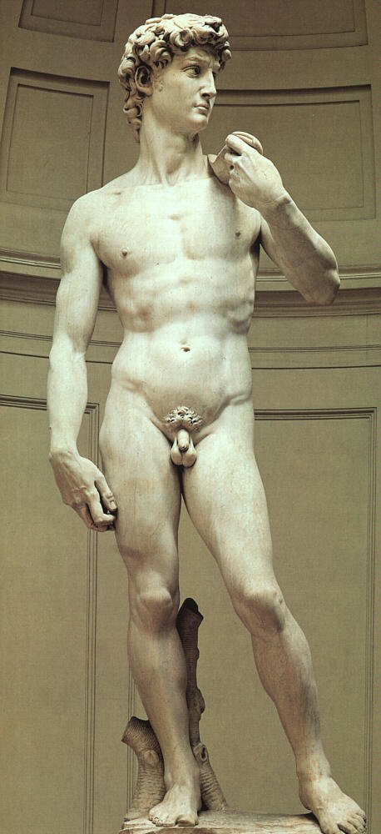
Long-term side effects of ADT Sarcopenic obesity
Prospective 12-week study, 25 men with locally advanced or recurrent prostate cancer, LHRH agonists
Smith MR et al. J Clin Endocrinol Metab 2006;91:1305–8
Notes:
A Prospective 12-week study, 25 men with locally advanced or recurrent prostate cancer, LHRH agonists by
Smith MR et al. Found an increase in the Fat mass, BMI and weight when patients were put on ADT.

Slide 18
CVD is the 2nd highest cause of death in prostate cancer patients, after prostate cancer itself
Cardiovascular co – morbidity may have special
prognostic significance for Prostate cancer patients
Newschaffer C J et. Al. JNCI Vol. 92, No. 8, April 19, 2000
Notes:
An observational study by Newschaffer indicates that CVD is the 2nd common reason for death in patients with PCa. The author also states that this CV co morbidity may also hold prognostic significance.

Slide 19
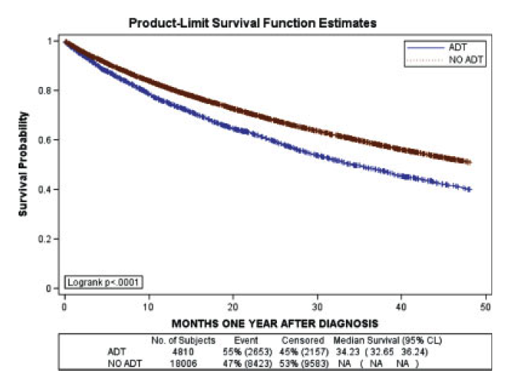
Cohort-based study of 22,816 men with newly diagnosed PCa men
Newly diagnosed prostate cancer patients who received ADT for at least 1 year were found to have a 20% higher risk of serious CV morbidity compared with similar men who did not receive ADT
Kaplan-Meier estimate of probability of CV events over time
Curves diverge rapidly
Saigal CS et al. Cancer 2007;110(7):1493–500
Notes:
Cohort-based study of 22,816 men with newly diagnosed PCa men
Newly diagnosed prostate cancer patients who received ADT for at least 1 year were found to have a 20% higher risk of serious CV morbidity compared with similar men who did not receive ADT

Slide 20
Side-Effects of ADT
“Big Three”
What you see
What you don’t see
What you feel
Loss of libido
Erectile dysfunction
Hot flashes
Weight gain
Gynecomastia
Loss muscle mass, strength
Decr size penis and testes
Hair changes
Loss of BMD
Anemia
Onset/worsening of lipids, HTN, CVD, diabetes
Fatigue,
Lack of energy,
Lack of initiative
Depression
Emotional lability
Cognitive function
Aches and pains

Slide 21
Loss of Libido and Erectile Dysfunction
Loss of libido
Difficult to overcome on ADT
Erectile dysfunction
Many causes
Consider counselor or sex therapist referral
Sexual rehabilitation¹
Intimacy and communication
1. Canada Cancer 2005
Notes:
Concept of penile “rehab”
Can libido be maintained?
Does penile rehab help in those without ED?

Slide 22
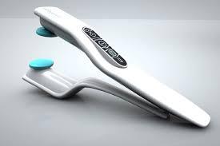
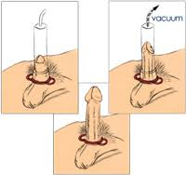
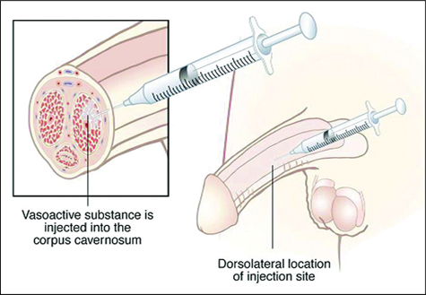
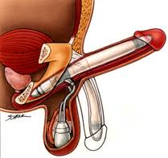
Penile rehabiltation for ED
First line therapy
Phosphodiesterase type 5 (PDE-5) inhibitors
Vibrator
Vacuum erection device (VED)
Combination
Second line therapy
(Intra cavernosal Injection)
Third line therapy (Penile prosthesis)

Slide 23
What you see: Gynecomastia
Often associated with breast tenderness
Generally not totally reversible
Made worse by weight gain
An ounce of prevention
Electron beam radiation of breast tissue
Treatment
Subcutaneous mastectomy
Notes:
Was the Payne date ever published?
Get/Add tam vs XRT paper

Slide 24
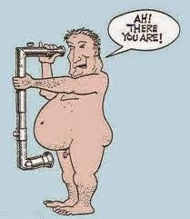
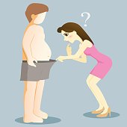
What you see: Decrease in Penile and Testicular Size
Up to 68% have penile shortening
Penile rehab
Post operative
During ADT
Shrinkage of testicles physiologic related to testosterone levels
1. Savoie J Urol 2003

Slide 25
The “Big Three” 3. Hot Flashes
75% have them but how bothersome?
11% “severely distressed” ¹
Emotional, physical symptoms
Can disturb sleep
Do not abate over time
Few well done prospective trials
Hot flash scales ^{2,3}
1. Spetz J Urol 2001 2. Quella Urol Nurs 1994 3. Moyad Urol Oncol 2005

Slide 26
Treatment Options for Hot Flashes
5-Hydroxytryptamine reuptake inhibitors
Sertraline (Zoloft) ²
Gabapentin (Neurontin) ³
Not effective or no longer recommended
Clonidine ⁵
Vitamin E ^{6, 7}
1. Quella J Urol 1999 2. Roth J Urol 1998 3. Guttso Neurology 2000. 4. Hammar J Urol 1999. 5. Loprinzi J Urol 1994 6. Lonn JAMA 2005 7. Miller Ann Int Med 2005
Notes:
Moyad article; importance of grading to determine and/or monitor severity

Slide 27
Treatment Options for Hot Flashes
Progestational agents
Megestrol acetate (Megace)¹
Depot medroxyprogesterone acetate²
Cyproterone acetate³
Estrogens
Diethylstilbestrol (DES)⁴
Estradiol patches^{5,6}
Estrogen gel
1. Loprinzi N Engl J Med 1994. 2. Charig Urology 1989 3. Cervenakov Int Urol Nephrol 2000 4. Atala A Urology 1992 . 5. Gerber GS Urology 2000. 6. Spetz J Urol 2001.
Notes:
Moyad article; importance of grading to determine and/or monitor severity

Slide 28
Weight Gain and Associated Changes
Median of 3-6 kg gain over 9-12 months ADT ^{1,2}
Decrease in lean body mass, 2-3%^{1,3,4}
Decrease in muscle strength⁵
Increase in total body fat, 10-20% ^{1,3,4}
Changes occur early (<18 mo) and do not continue ⁴
Difficult to loose weight even if ADT stopped²
1. Smith MR J Clin Endocrinol Metab 2002 2. Higano CS Urology 1996 3. Berruti A J Urology 2002 4. Lee Cancer 2005 5. Segal J Clin Oncol 2004
Notes:
Show a bar graph with different studies showing amount of weight gain per number of months on ADT

Slide 29
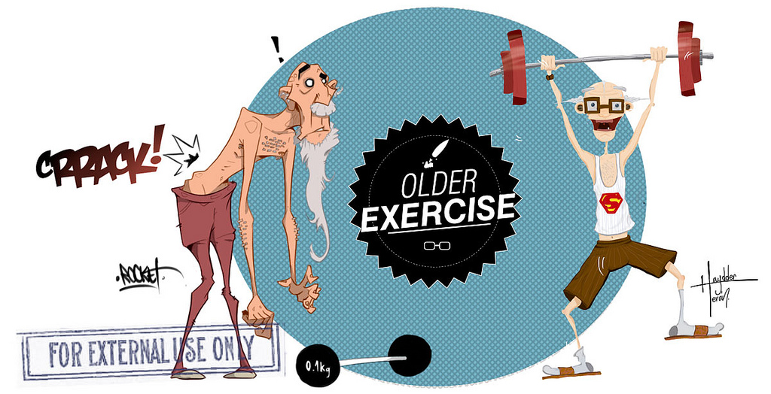
Preventive Approach
Early consultation with nutritionist
Discuss healthy diet to maintain or lose weight
Snacking strategies
Recommend daily calcium and vit D intake
Physical therapist or licensed trainer
Aerobic exercise routines

Slide 30
Exercise helps
What kind?
Aerobic
Resistance
Stretching
How to accomplish?
With help and support
Make it a part of the schedule
work out slowly

Slide 31
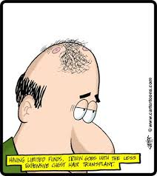
What you see: Hair Changes
Thinning or loss of body hair
Unexpected
Distressing
Beard softer
Educate the patient
Reversible

Slide 32
What you don’t see:

Slide 33
Loss of Bone Mineral Density
A significant low BMD before ADT¹
Many prostate cancer patients have low vit D levels
Men tend to have a low dietary intake of calcium
BMD loss occurs at greater rate than seen in women ^{2, 3}
Risk of fracture is increased ^{4, 5}
Unlike weight gain, BMD loss continues over time ⁶
1. Smith MJ Cancer 2001 2. Higano Urology 2004 3. Smith MR NEJM 2001 4. Shahinian NEJM 2005 5. Smith J Clin Oncol 2005 6. Lee Cancer 2005
Notes:
Show data quickly rather than bullet slide or

Slide 34
BMD Evaluation and Treatment
Monitor BMD, during ADT¹
Treat osteoporosis
Zoledronic acid (Zometa)*²plus calcium and vit D
Estrogens
*not approved for treatment of male osteoporosis
1. Higano Urol Clin North Amer 2004 2. Smith J Urol 2003

Slide 35
What you don’t see: Anemia
Incidence up to 90%^{1, 2}
Usually mild to moderate
Normochromic, normocytic
Does not correlate with fatigue symptoms
Responds well to erythropoietin ^{3,4}
Reversible
1. Crawford Cancer 1990 2. Strum J Urol 1997 3. Strum Br J Urol 1997 4. Beshara Prostate 1997

Slide 36
What you don’t see: ADT Induces Insulin Resistance-Like Syndrome
Hyperlipidemia ^{1, 2}
Glucose intolerance ^{3, 4, 5}
Hypertension ^{3, 4}
Increased cardiovascular risk ^{3, 4, 6}
1. Arrer J Clin Endocrin Metab 1996 2. Smith MR J Clin Endocrin Metab 2002 3.Higano Urology 1996 4. Inaba Metabolism 2005 5. Basaira Cancer 2006 6. Keating J Clin Oncol 2006

Slide 37
Recommendations
Monitor
Serum glucose
Lipids
Blood pressure
Weight
Exercise
Diet
Treat hyperlipidemia, hypertension, diabetes

Slide 38
What you feel:

Slide 39
Fatigue, Lack of Energy or Initiative
Probably underestimated
“Severe” fatigue in 14% after 3 months ADT¹
Appears to be independent of psychological issues or anemia ²
1. Stone P Eur J Cancer 2000 2. Choo R Can J Urol 2005

Slide 40
What you feel: Depression
Major depressive disorders seen in 13% of men on ADT¹
8 times higher than general male population
Prior history of depression is a risk factor
Oncologists are bad at recognizing depression²
1. Pirl Psycho-Oncology 2002. 2. Passik J Clin Oncol 1998
Notes:
Role of clinical psychologist/psychosocial support for both the patient and t he spouse/family

Slide 41
Managing emotional side effects
Assess for pre-existing depression history
Treat or refer for anti-depressant therapy
Exercise
1. Fava J Clin Psychiat 2005

Slide 42
Strategies to Address Side-Effects
Lifestyle changes ¹
Diet
Exercise
Calcium and vitamin D
Monitor and treat co-morbidities
Sexual rehabilitation, couples counseling
Intermittent ADT
1. Chan Proc 2006 Prostate Cancer Symposium abstract #20

Slide 43
Multidisciplinary effort
Urologist, medical oncologist, radiation oncologist
Internist
Dietician
Physical therapist, trainer
Nurses
Social worker
Psychologist, psychiatrist
Sex therapist

Slide 44
Conclusions
ADT can cause significant physical, emotional and cognitive changes
Consider co-morbidities of patient in light of many potential complications
Patients must be educated as to what to expect
Counseling patients on proactive strategies
Minimize side-effects
Give patients a greater sense of control
Modulate disease progression?

Slide 45
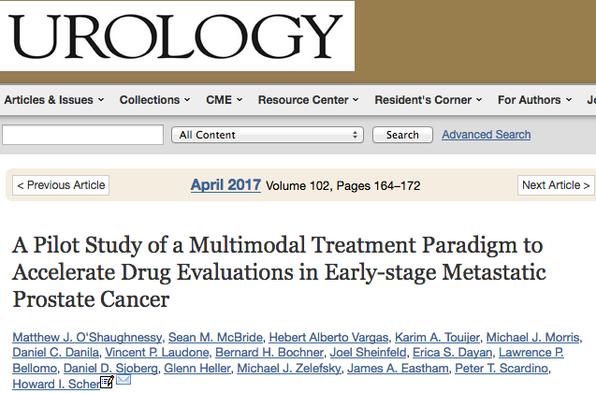
From palliation to cure in mCAP
A sequentially applied multimodal treatment strategy can eliminate detectable disease in selected patients with metastatic spread at diagnosis.
The end point of undetectable PSA after testosterone recovery should be considered when evaluating new approaches to rapidly set priorities for large-scale testing in early metastatic disease states and to shift the paradigm from palliation to cure.

Slide 46
Thank you for the attention

Slide 49
What do these have in common?
Hot flashes
Loss of bone density
Depression
High blood pressure, diabetes, increased lipids
Decreased muscle mass
Weight gain
Change in cognitive function
Fatigue, loss of initiative

