Slide 1
PPI Anti Incontinence Devices

Slide 2
PPI

Slide 3
The initial management of PPI
Lifestyle interventions,
Pelvic floor muscle training with or
without
Biofeedback, and
Bladder training.
An early start of conservative treatment is recommended during the first year.

Slide 4
Step II RX PPI
Minimally invasive
Injection of urethral bulking agents,
Male suburethral sling,
Adjustable continence balloons / Clamps.
Invasive treatments.
Artificial urinary sphincter implantation

Slide 5
Bone Anchor InVance®

Slide 6
AdVance Transobturator male Sling

Slide 7
AdVance Transobturator male Sling

Slide 8
Adjustable continence balloons
Adjustable continence balloons, which are one of the most recent treatments, create passive compression of the urethra by two balloons located on either side of the urethra.
The ProACT (Uromedica, Plymouth, MN, USA) is an adjustable continence therapy option and is a minimally invasive modality with a cost that is remarkably less than that of the AUS.

Slide 9
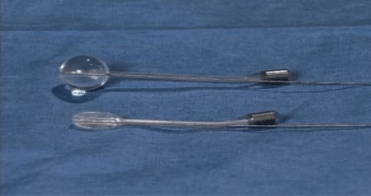
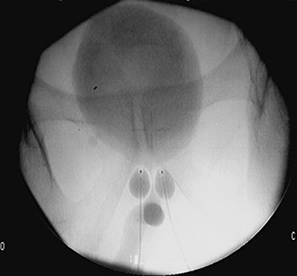
Tubing runs from each balloon to titanium ports placed on the back of the scrotum.
The balloons are filled with sterile water through these ports.
At 1 month and thereafter, the balloons are refilled with 1-ml increments of this solution (maximum of 8 ml) until continence is reached.
Postoperative readjustment is very simple, and only local anesthesia is necessary.

Slide 10
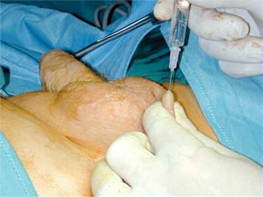
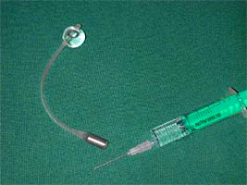

Slide 11
Complications
Urethral perforation,
Bladder perforation
May necessitating termination of the implant on the perforated side.

Slide 12
AUS (Arteficial urinary sphincter)
AUS is still the gold standard of treatment for PPI
It is associated with high continence and high patient satisfaction rates.

Slide 13
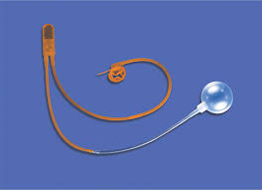
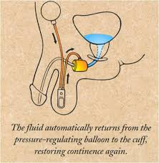
AUS

Slide 14
Thank you for the attention
Any questions?

